Slide 1

Introduction to Recurrent Neural Networks

Slide 2
Outline
RNN basic
RNN
LSTM, GRU
Applications
Sentiment analysis
Language model
Sequence tagging
Machine translation, conversation model
Reference

Slide 3
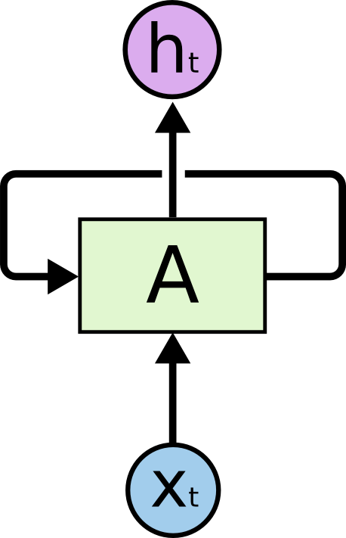
Recurrent Neural Net
Output
Elman Network
Input

Slide 4
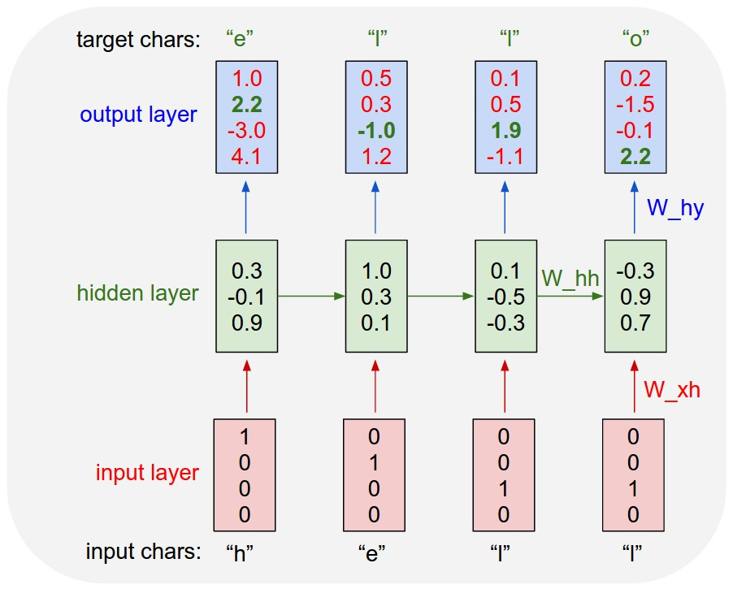

Recurrent Neural Networks
Equation
$$h_{t}=tanh⁡(W_{hh}h_{t−1}+W_{xh}x_{t})$$
$$y_{t}=W_{hy}h_{t}$$
class RNN:
def step(self, x):
self.h = np.tanh(np.dot(self.W_hh, self.h) +
np.dot(self.W_xh, x))
y = np.dot(self.W_hy, self.h)
return y
[Karpathy, Colah]

Slide 5
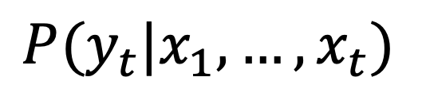
Recurrent Neural Networks
[Karpathy, Colah]
$$P(y_{t}|x_{1},…, x_{t})$$

Slide 6
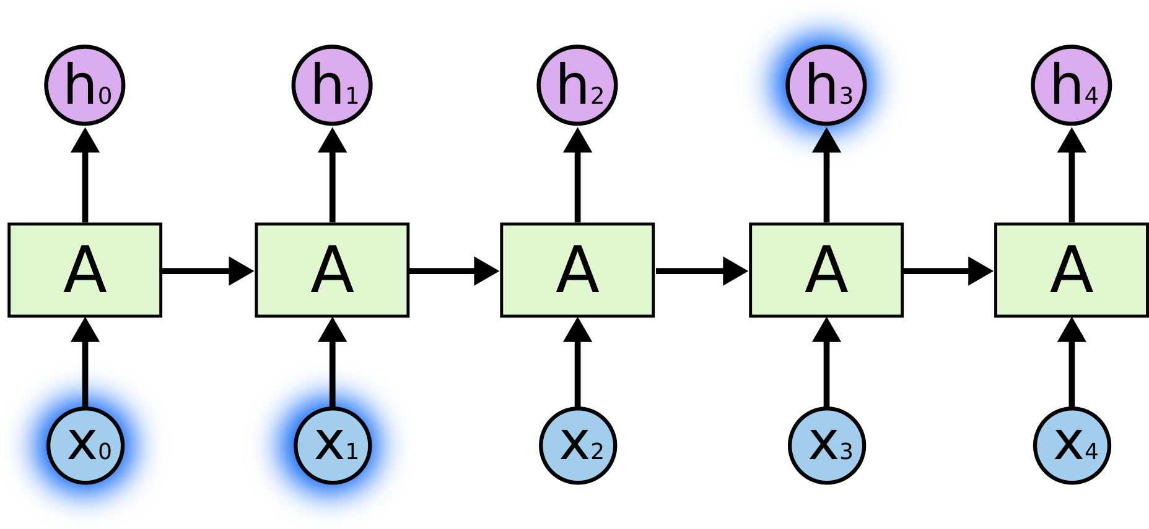
Back-propagation Through Time (BPTT)
Vanishing or exploding gradient problem
E0
E1
E2
E3
E4
[Colah]

Slide 7
Vanishing or exploding gradient problem
Notes:
As the gradients are multiplied over time they are susceptible to exploding (several large >>1 gradients one after the other) or vanishing (several small <<1 multiplied one after the other).
The large ones are relatively easy to solve: they can be clipped.
The vanishing ones are problematic, as they slow the convergence significantly

Slide 8

LSTM
Notes:
Gate: Optionally let information through
Cell state: long term memory
Forget gate: determine what old information to forget
Input gate: determine what new information to store
Output gate: decide what to output
https://deeplearning4j.org/lstm.html

Slide 9
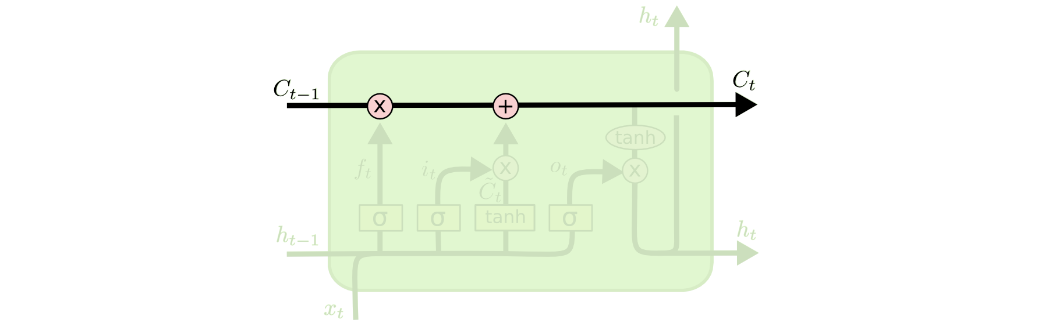
Cell State – Long-term memory
[Colah]

Slide 10
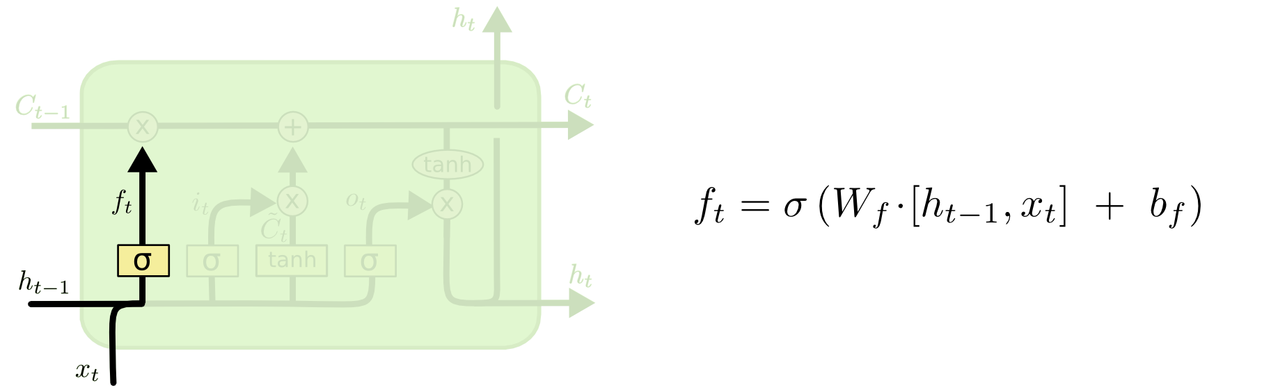
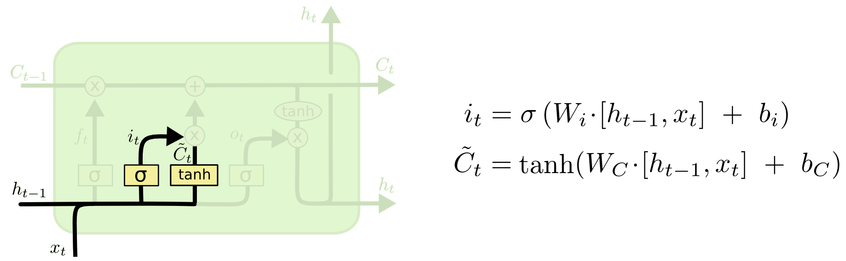
Forget Gate, Input Gate
Forget Gate - determine what old information to forget
Input Gate - determine what new information to store
[Colah]

Slide 11
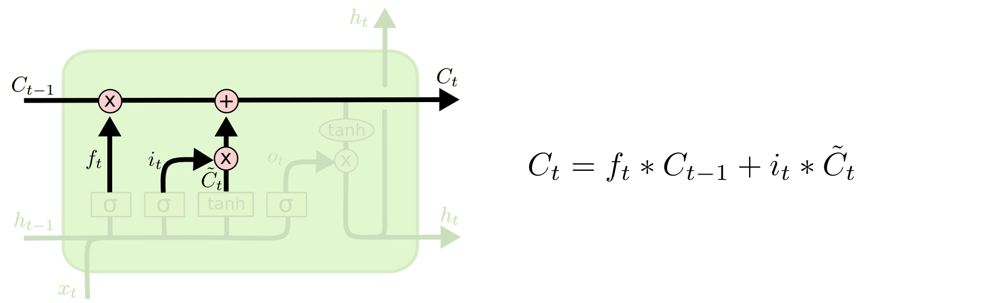
Update Cell State based on Input, Forget Gates
[Colah]

Slide 12
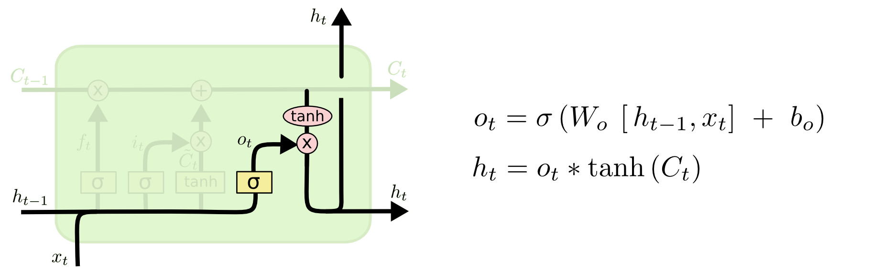
Output Gate
[Colah]

Slide 13
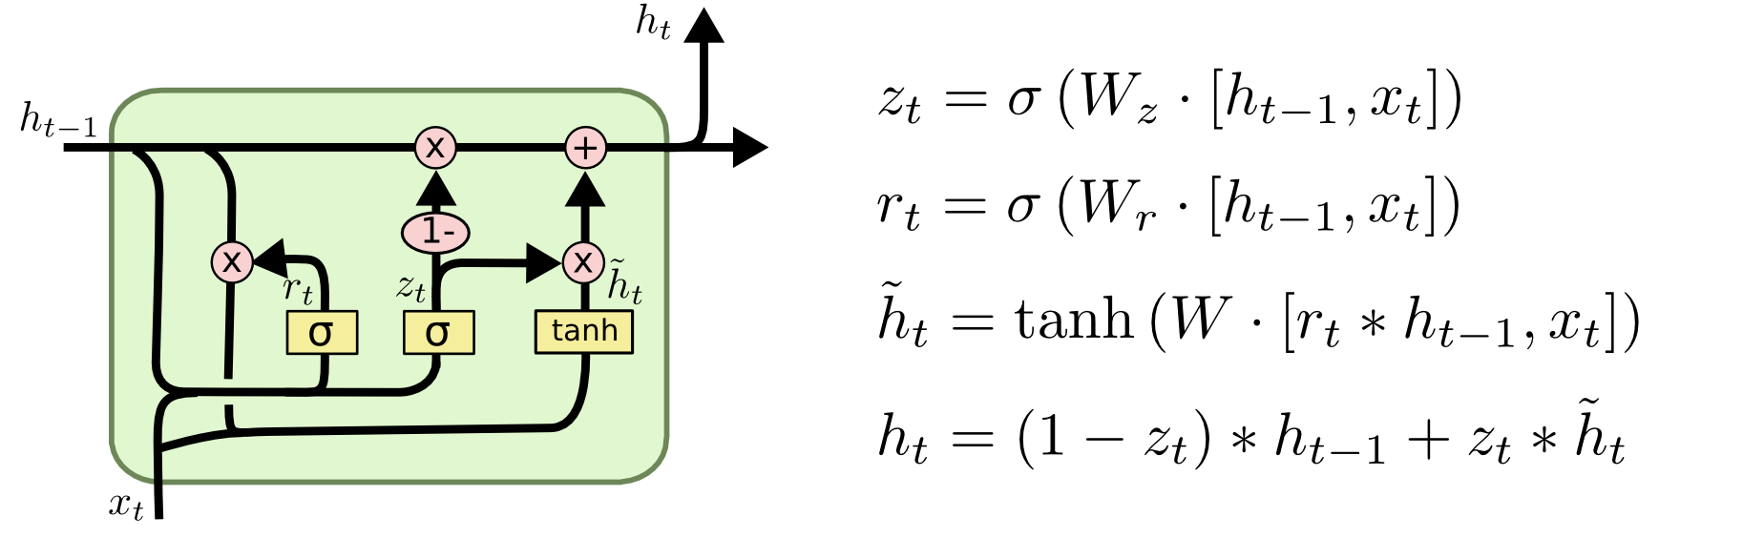
Gated Recurrent Unit (GRU)
Merge cell state and hidden state
Combine forget and input gates
[Colah]
Notes:
It is basically an lstm without an output gate, hence it writes the content of its memory ht to the rest of the network

Slide 14
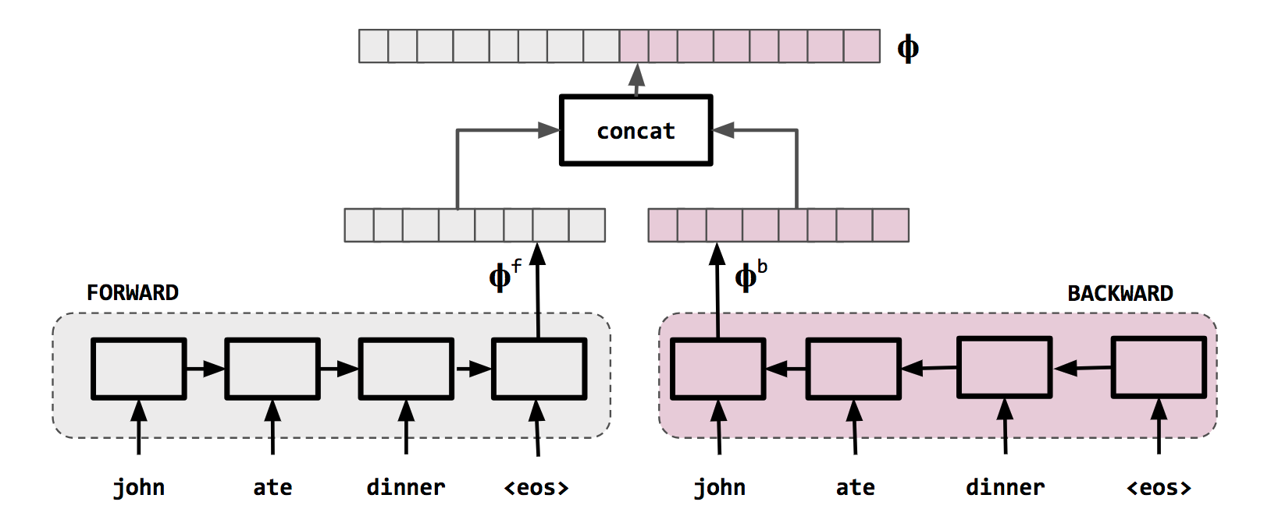
Bi-Directional RNN/LSTM/GRU
Rao, McMahan. Natural Language Processing with PyTorch. O'Reilly Media.

Slide 15
Applications

Slide 16
RNN Applications
Extract a vector from a sequence -> classify sequences
Extract a vector at each step of a sequence -> predict sequences

Slide 17
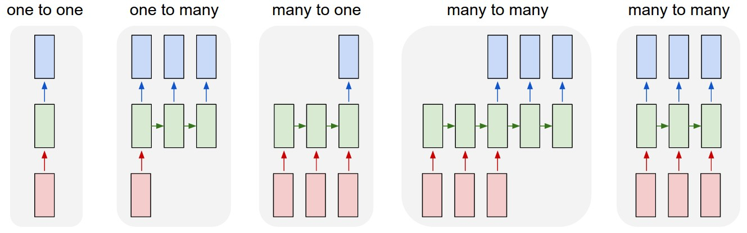
RNN Applications
Classification
Caption
Sentiment Analysis
Seq2Seq Translation
Language Model
http://karpathy.github.io/2015/05/21/rnn-effectiveness/

Slide 18
RNN Language Model
[A. Karpathy]

Slide 19
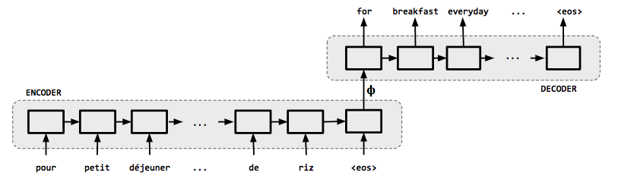
Sequence-to-Sequence Encoder-Decoder
Rao, McMahan. Natural Language Processing with PyTorch. O'Reilly Media.
Extract vectors from a sequence
Generate a new sequence
-> Machine Translation!

Slide 20
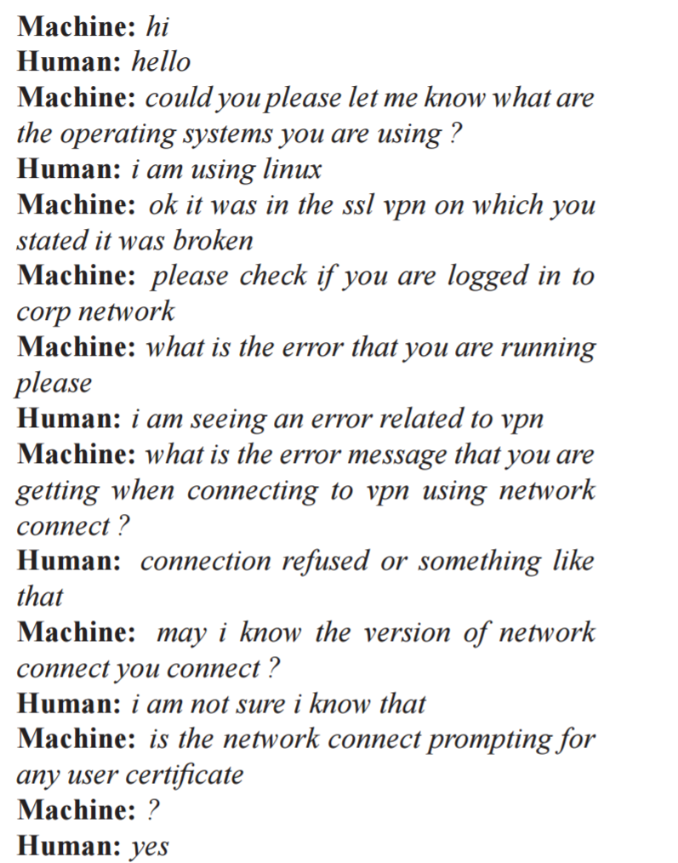
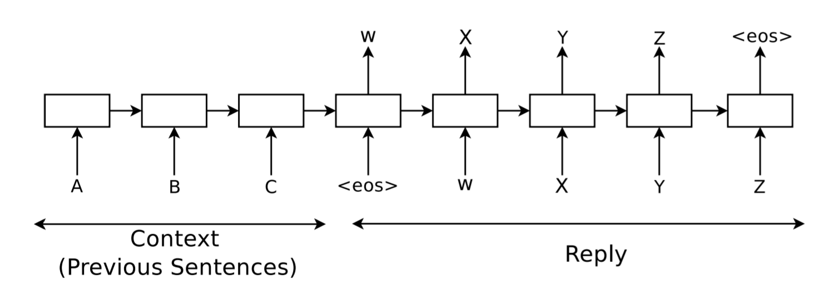
Conversational Model
Notes:
https://arxiv.org/pdf/1506.05869.pdf

Slide 21
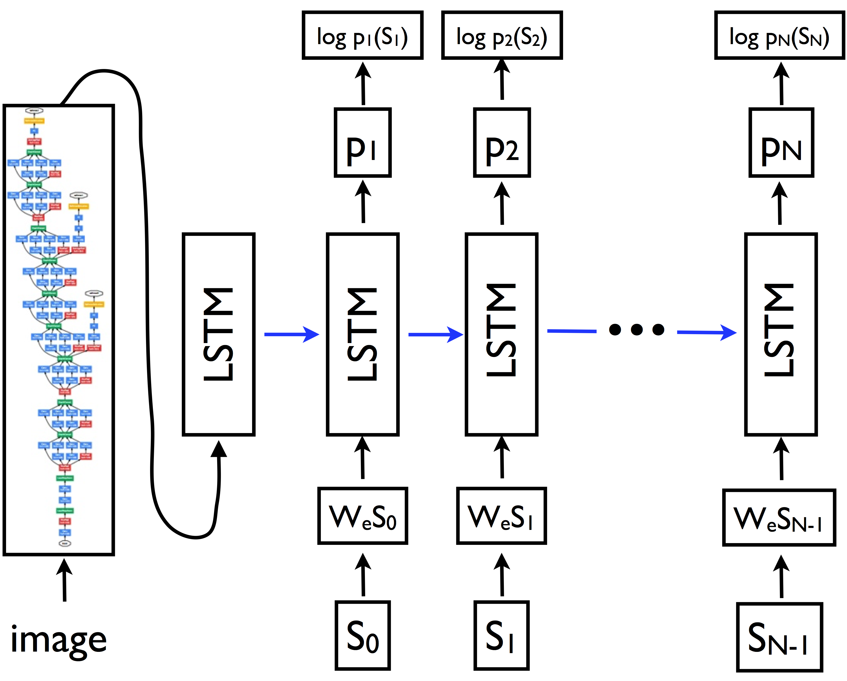

Image Caption
[Vinyals, Xu]
Notes:
https://arxiv.org/abs/1411.4555

Slide 22
Reference
RNN: http://karpathy.github.io/2015/05/21/rnn-effectiveness/
LSTM: http://colah.github.io/posts/2015-08-Understanding-LSTMs/
LSTM: http://deeplearning.cs.cmu.edu/pdfs/Hochreiter97_lstm.pdf
RNN, LSTM: https://www.cs.ox.ac.uk/people/nando.defreitas/machinelearning/lecture11.pdf
GRU: http://arxiv.org/pdf/1406.1078v3.pdf
Sequence to Sequence: https://papers.nips.cc/paper/5346-sequence-to-sequence-learning-with-neural-networks.pdf
Attention: https://arxiv.org/abs/1409.0473
Rao, McMahan, “Natural Language Processing with PyTorch”, O’Reilly

